Slide 1


Design-for-Manufacturability in Chip Design
Design-for-Manufacturability (DFM) is a critical aspect of chip design, ensuring efficient and successful fabrication of integrated circuits.
by Wai-Shing Luk

Slide 2

Importance of DFM in Chip Design
DFM plays a crucial role in maximizing chip yield, minimizing production costs, and meeting time-to-market deadlines.
Yield Enhancement
DFM techniques help optimize chip design for efficient fabrication, leading to higher yields and reduced manufacturing costs.
Cost Optimization
By minimizing manufacturing complexities and defects, DFM contributes to cost savings by reducing rework and scrap rates.
Time-to-Market
Efficient DFM practices help streamline the manufacturing process, enabling faster production and quicker time-to-market.

Slide 3

Key Principles of DFM
DFM principles focus on optimizing the chip design for manufacturability, ensuring the smooth transition from design to production.
1
Design Rule Checking
Ensuring that the chip design adheres to specific layout rules and constraints for fabrication.
2
Layout Optimization
Minimizing design complexity and maximizing manufacturability by optimizing the chip layout.
3
Process Variability
Considering potential variations in the manufacturing process to ensure consistent chip performance.
4
Testability
Designing for testability, enabling efficient testing and defect detection during production.

Slide 4

Manufacturability Considerations in the Design Process
DFM considerations should be integrated early in the design process to avoid costly redesign and rework.
1
Design Concept
DFM considerations should be incorporated into the initial design concept to minimize potential manufacturing challenges.
2
Layout Design
DFM principles should guide the layout design, ensuring manufacturability and minimizing potential defects.
3
Verification and Simulation
DFM verification and simulation tools should be utilized to analyze the manufacturability of the chip design.

Slide 5
Design Rule Checking and DFM Validation
Design rule checking (DRC) and DFM validation are crucial steps to ensure manufacturability and avoid production issues.
Design Rule Checking
DFM Validation
DRC tools automatically verify that the chip design complies with specific design rules and constraints.
DFM validation involves simulating the manufacturing process to identify potential issues and optimize the design for manufacturability.

Slide 6

Yield Optimization and DFM
DFM plays a vital role in maximizing chip yield, leading to cost-effective and efficient production.
Yield Enhancement
DFM techniques contribute to higher yields by minimizing design complexities and defects.
Cost Reduction
Improved yield leads to reduced manufacturing costs, as fewer defective chips are produced.
Quality Improvement
DFM practices ensure consistent chip quality, leading to reliable and high-performance products.

Slide 7




DFM for Advanced Semiconductor Nodes
DFM becomes increasingly crucial at advanced semiconductor nodes, where feature sizes shrink and manufacturing processes become more complex.
Design Rule Challenges
DFM techniques need to address new design rules and constraints arising from shrinking feature sizes.
Process Variability
Managing process variations becomes more critical at advanced nodes due to the increased sensitivity of the manufacturing process.
Emerging Materials
DFM techniques need to accommodate the use of new materials and fabrication processes.

Slide 8




DFM Challenges in Emerging Technologies
Emerging technologies like 3D integration and heterogeneous integration pose new challenges for DFM.
3D Integration
DFM techniques need to address the complexities of stacking multiple layers of chips in 3D integration.
Heterogeneous Integration
DFM needs to ensure seamless integration of different types of chips with varying materials and fabrication processes.
Quantum Computing
DFM faces unique challenges in manufacturing quantum computing chips, which require extremely precise fabrication and control.

Slide 9

Collaboration between Design and Manufacturing Teams
Close collaboration between design and manufacturing teams is essential for successful DFM implementation.
1
Early Communication
Open communication between design and manufacturing teams from the early stages of design is crucial.
2
Shared Knowledge
Sharing expertise and best practices between design and manufacturing teams enhances DFM effectiveness.
3
Iterative Process
An iterative process of design, analysis, and feedback between design and manufacturing teams optimizes DFM implementation.

Slide 10

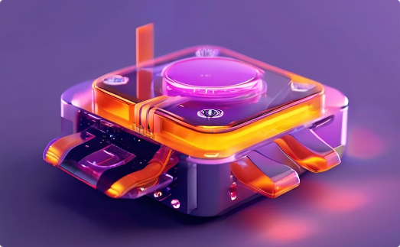
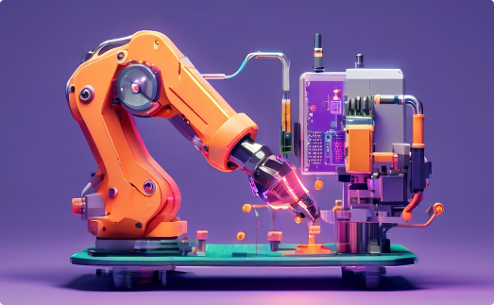
Conclusion and Future Trends in DFM
DFM continues to evolve alongside emerging technologies and manufacturing advancements.
Advanced Design Rules
3D and Heterogeneous Integration
Automation and AI
DFM will need to address increasingly complex design rules and constraints as technology advances.
Automation and AI will play a larger role in DFM, streamlining design and manufacturing processes.
DFM techniques will be crucial for enabling efficient and reliable 3D and heterogeneous integration.

